Slide 1
2D ARRAYS
Dr. Himanshi Babbar
Department of Computer Science and Engineering Chitkara University, Punjab
1

Slide 2






Contents
Introduction
2D Arrays
Python Syntax
Update, Access elements in 2D

Slide 3



Python 2D array
An array is a collection of linear data structures that contain all elements of the same data type in contiguous memory space.
It is like a container that holds a certain number of elements that have the same data type.
An array's index starts at 0, and therefore, the programmer can easily obtain the position of each element and perform various operations on the array.
Two-Dimensional Array (2D Array)
A 2D array is an array of arrays that can be represented in matrix form like rows and columns. In this array, the position of data elements is defined with two indices instead of a single index.
Syntax:
Array_name = [rows][columns] # declaration of 2D array
Arr-name = [ [m1, m2, m3, … . m_{n}], [n1, n2, n3, … .. n_{n}] ]
Where m is the row and n is the column of the table.

Slide 4
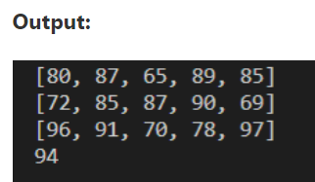
Access Two-Dimensional Array
In python, we can access elements of a two-dimensional array using two indices.
The first index refers to the indexing of the list and the second index refers to the position of the elements.
If we define only one index with an array name, it returns all the elements of 2-dimensional stored in the array.
Let's create a simple program to understand 2D (two dimensional) arrays in Python.
Student_dt = [ [72, 85, 87, 90, 69], [80, 87, 65, 89, 85], [96, 91, 70, 78, 97], [90, 93, 91, 90, 94], [57, 89, 82, 69, 60] ]
#print(student_dt[])
print(Student_dt[1]) # print all elements of index 1
print(Student_dt[0]) # print all elements of index 0
print(Student_dt[2]) # print all elements of index 2
print(Student_dt[3][4]) # it defines the 3rd index and 4 position of the data element.

Slide 5
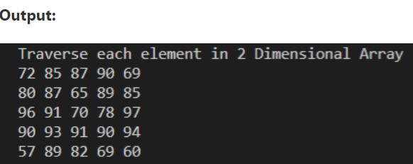
Traversing the element in 2D (two dimensional)
# write a program to traverse every element of the two-dimensional array in Python.
Student_dt = [ [72, 85, 87, 90, 69], [80, 87, 65, 89, 85], [96, 91, 70, 78, 97], [90, 93, 91, 90, 94], [57, 89, 82, 69, 60] ]
# Use for loop to print the entire elements of the two dimensional array.
for x in Student_dt: # outer loop
for i in x: # inner loop
print(i, end = " ") # print the elements
print()

Slide 6
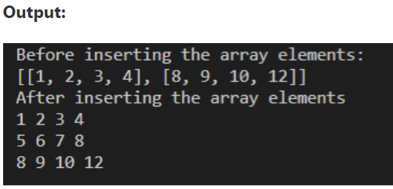
Insert elements in a 2D (Two Dimensional) Array
We can insert elements into a 2 D array using the insert() function that specifies the element' index number and location to be inserted.
# Write a program to insert the element into the 2D (two dimensional) array of Python.
from array import * # import all package related to the array.
arr1 = [[1, 2, 3, 4], [8, 9, 10, 12]] # initialize the array elements.
print("Before inserting the array elements: ")
print(arr1) # print the arr1 elements.
# Use the insert() function to insert the element that contains two parameters.
arr1.insert(1, [5, 6, 7, 8]) # first parameter defines the index no., and second parameter defines the elements
print("After inserting the array elements ")
for i in arr1: # Outer loop
for j in i: # inner loop
print(j, end = " ") # print inserted elements.
print()

Slide 7
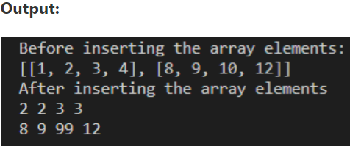
Update elements in a 2 -D (Two Dimensional) Array
In a 2D array, the existing value of the array can be updated with a new value. In this method, we can change the particular value as well as the entire index of the array.
from array import * # import all package related to the array.
arr1 = [[1, 2, 3, 4], [8, 9, 10, 12]] # initialize the array elements.
print("Before inserting the array elements: ")
print(arr1) # print the arr1 elements.
arr1[0] = [2, 2, 3, 3] # update the value of the index 0
arr1[1][2] = 99 # define the index [1] and position [2] of the array element to update the value.
print("After inserting the array elements ")
for i in arr1: # Outer loop
for j in i: # inner loop
print(j, end = " ") # print inserted elements.
print()

Slide 8
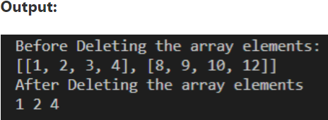
Delete values from a 2D (two Dimensional) array
In a 2- D array, we can remove the particular element or entire index of the array using del() function in Python.
from array import * # import all package related to the array.
arr1 = [[1, 2, 3, 4], [8, 9, 10, 12]] # initialize the array elements.
print("Before Deleting the array elements: ")
print(arr1) # print the arr1 elements.
del(arr1[0][2]) # delete the particular element of the array.
del(arr1[1]) # delete the index 1 of the 2-D array.
print("After Deleting the array elements ")
for i in arr1: # Outer loop
for j in i: # inner loop
print(j, end = " ") # print inserted elements.
print()
6

Slide 9
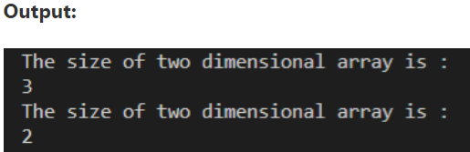
Size of a 2D array
A len() function is used to get the length of a two-dimensional array. In other words, we can say that a len() function determines the total index available in 2-dimensional arrays.
Let's understand the len() function to get the size of a 2-dimensional array in Python.
array_size = [[1, 3, 2],[2,5,7,9], [2,4,5,6]] # It has 3 index
print("The size of two dimensional array is : ")
print(len(array_size)) # it returns 3
array_def = [[1, 3, 2], [2, 4, 5, 6]] # It has 2 index
print("The size of two dimensional array is : ")
print(len(array_def)) # it returns 2

Slide 10
Cont…
Write a program to print the sum of the 2-dimensional arrays in Python.
def two_d_matrix(m, n): # define the function
Outp = [] # initially output matrix is empty
for i in range(m): # iterate to the end of rows
row = []
for j in range(n): # j iterate to the end of column
num = int(input(f "Enter the matrix [{0}][{j}]"))
row.append(num) # add the user element to the end of the row
Outp.append(row) # append the row to the output matrix
return Outp
def sum(A, B): # define sum() function to add the matrix.
output = [] # initially, it is empty.
print("Sum of the matrix is :")
for i in range(len(A)): # no. of rows
row = []
for j in range(len(A[0])): # no. of columns

Slide 11
Cont…
row.append(A[i][j] + B[i][j]) # add matrix A and B
output.append(row)
return output # return the sum of both matrix
m = int(input("Enter the value of m or Row\n")) # take the rows
n = int(input("Enter the value of n or columns\n")) # take the columns
print("Enter the First matrix ") # print the first matrix
A = two_d_matrix(m, n) # call the matrix function
print("display the first (A) matrix")
print(A) # print the matrix
print("Enter the Second (B) matrix ")
B = two_d_matrix(m, n) # call the matrix function
print("display the Second (B) matrix")
print(B) # print the B matrix
s= sum(A, B) # call the sum function
print(s) # print the sum of A and B matrix.

Slide 12
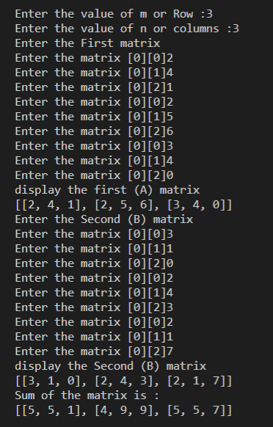
Output:
10

Slide 13
Python List Comprehension

Slide 14
Introduction
Python is known for helping us produce code that is elegant, simple to write, and reads almost as well as plain English.
List comprehension is one of the language's most distinguishing features, allowing us to develop sophisticated functionality with just one line of code.
On the other hand, many Python writers struggle to fully utilize the more complex aspects of list comprehension.
Sometimes programmers may overuse them, resulting in much less efficient and difficult-to-read code.
Using List Comprehension
newlist = [expression for item in iterable if condition == True]

Slide 15

Example
#using for loop to iterate through items in list
numbers = [3, 5, 1, 7, 3, 9]
num = []
for n in numbers:
num.append(n**2)
print(num)

Slide 16
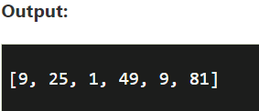
All of this can be accomplished with only single line of code using list comprehension.
#using list comprehension to iterate through list items
numbers = [3, 5, 1, 7, 3, 9]
num = [n**2 for n in numbers]
print(num)

Slide 17
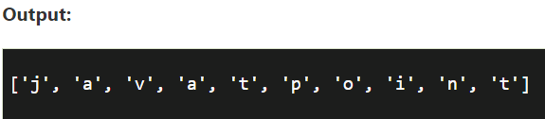
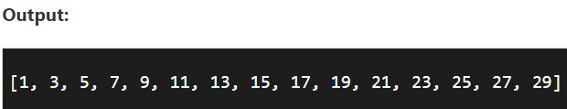
Using List Comprehension to Iterate through String
List comprehension can be used in case of strings also as they are iterables too.
letters = [ alpha for alpha in ’Python' ]
print( letters)
Using Conditions in List Comprehension
Conditional statements can be used by list comprehensions to change existing lists (or other tuples). We'll make a list with mathematical operators, numbers, and a range of values.
number_list = [ num for num in range(30) if num % 2 != 0]
print(number_list)

Slide 18
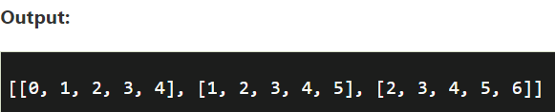
Nested List Comprehensions
Nested List Comprehensions are similar to nested for loops in that they are a list comprehension inside another list comprehension.
nested_list = []
for _ in range(3):
# Append an empty sublist inside the list
nested_list.append([])
for __ in range(5):
nested_list[_].append(__ + _)
print(nested_list)

Slide 19
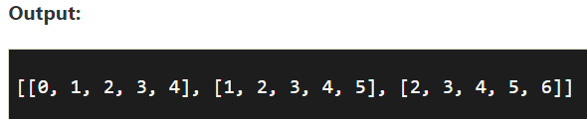
# Nested list comprehension nested_list = [[_ + __ for _ in range(5)] for __ in range(3)] print(nested_list)
List comprehension is a powerful tool for describing and creating new lists based on existing ones.
In general, list comprehension is lighter and easier to use than traditional list construction functions and loops.
To provide user-friendly code, we should avoid writing large codes for list comprehensions.
Every interpretation of the list or other iterables can be recast in a for loop, but not all the for loops can be rebuilt in the framework of list comprehension.

Slide 20





